Slide 1

Table of Content
1st Page | Home Page
2nd Page | Buildings Page
3rd Page | Contracts Page
4th Page | Workers Page
5th Page | About us Page
6th Page | Contact us Page
Aqark

Slide 2
Website Objectives
1st | Simplify the organization and order of the buildings
2nd | Allow the conduction and payment of contracts
3rd | Organize the contracts and workers
4th | Reduce the effort needed to organize buildings, make contracts, and give salary payments
Aqark

Slide 3

There are some websites that use the same functions and are published online.
For example:
1- EMAAR (https://www.emaar.com/)
2- Oman Metal Industries (https://omanmetalindustries.com/)
Note
Aqark
The functions won't be accessible as the website content is private for workers only

Slide 4
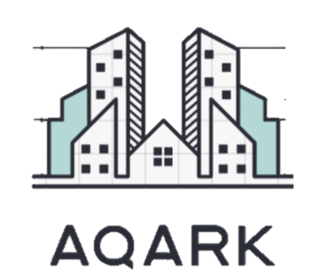
Note
The logo of the website will include the image of buildings above the design of its name.
Aqark

Slide 5
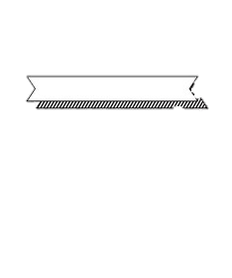
Website Requirement and Information
Login Page
Payment Page
Buildings Page
Profile Page
1-Username
2-Password
3-Email
1-Credit Card
2-Information
3-Email
1-Video
2-Building info
1-User info
2-Date of submission
Aqark
The functions won't be accessible as the website content is private for workers only

Slide 6
Website Hosting Suggestion
Hostinger
Ionos
Result
Hostinger delivers fast, secure, and user-friendly managed web hosting services with excellent uptime. A generous list of hosting features and free extras make Hostinger’s offer one of the best on the market.
The entry-level Essential plan offers 10 GB of storage, 10 databases, a free domain for the first year, and daily backups for one website. As for security, one free wildcard SSL certificate, a site scan, and DDoS protection are included to safeguard you from various threats.
The best one to choose is Hostinger, as it is classified as the best hosting-system website and the cheapest, also it has the best servers along with unlimited data storage to be used.
Aqark
The functions won't be accessible as the website content is private for workers only

Slide 7
Issues
Impact issues
Ethical and Professional Issues
The website might cause problem to the organization and payment of contracts.
Also it can cause workers to quit and leave due to less work needed.
The company will require less workers, which will cause the less cost of salaries.
Also the creation of contracts will be simpler.
Also Less effort will be needed to make buildings and share information.
Aqark

